Slide 1
What can you do with a Raspberry Pi?
Linda MacPhee-Cobb

Slide 2
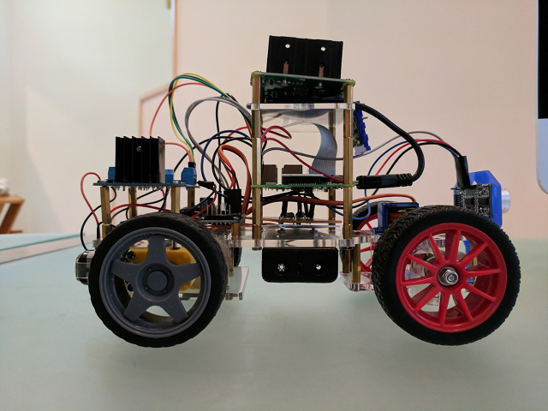
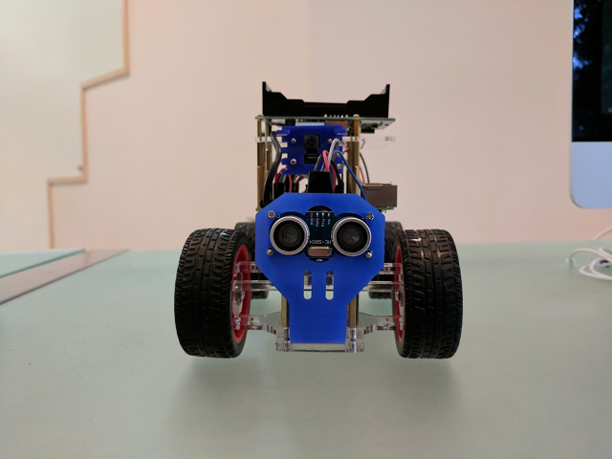
Mobile Robots
Sensors: UltraSonic distance sensor, Camera
LED output when spotting Min, Merlin
Trained using Google’s TF Mobile Models
Obstacle avoidance with simple RL

Slide 3
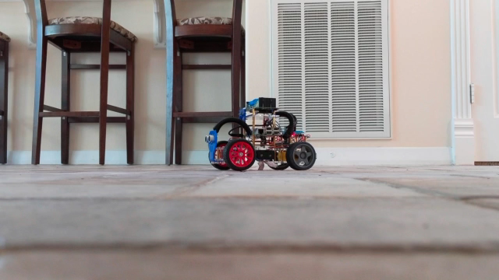
Self teaching
Using a small state space and one objective RL is easy
Multiple objectives is mostly unsolved
Blondie24 did for checkers everything Google Brain does with Go
on mid 1990s computers

Slide 4
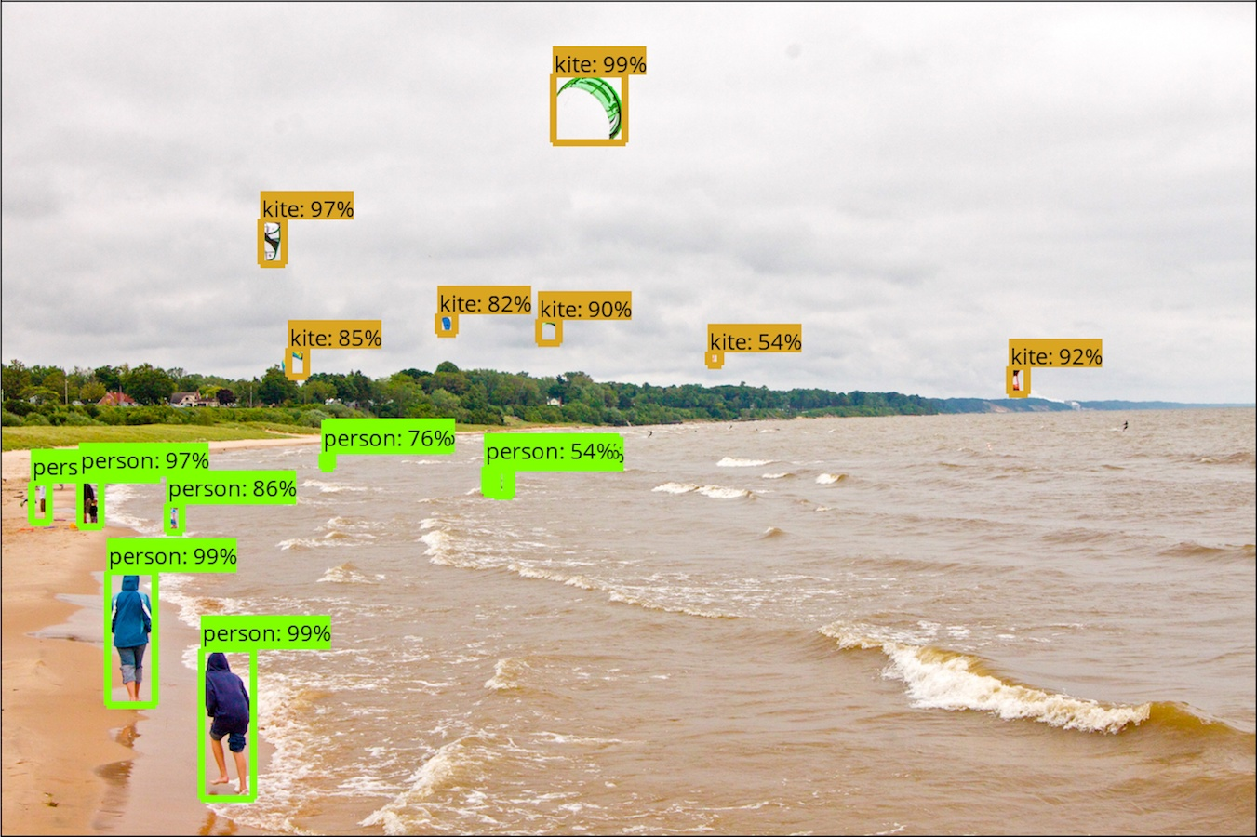
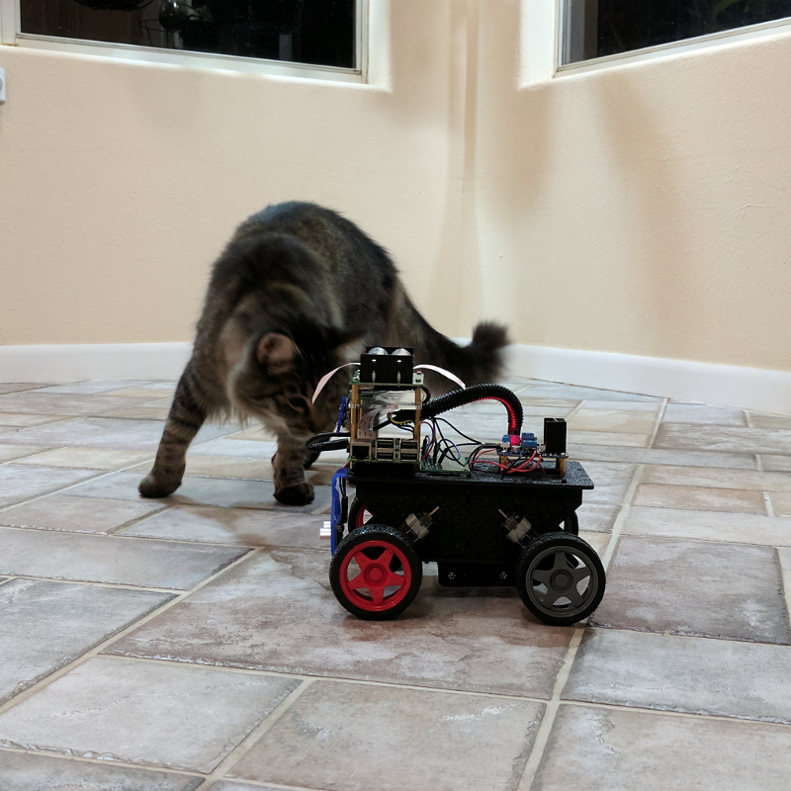
Image classification
Out of the box Google Mobile Network recognizes many objects ~ 10secs/frame
Re-trained on smaller sets ( both cats ) runs ~ 2 frames/second
~100 images each category, 3 categories (Min, Merlin, No cat)
~30 mins on desktop, copy trained network onto Pi

Slide 5
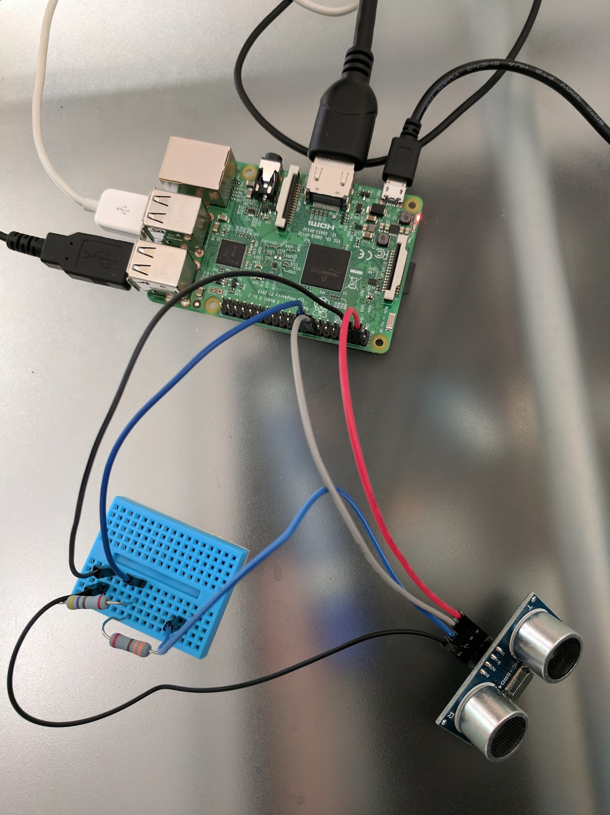
UltraSonic Distance Sensor
AI and ML Robotics Group ( Stanford ) trained several robots to map rooms
using SLAM
Bumped into a RE Agent at EPO who was using these sensors to create floor plans
by following walls
Car robot learns obstacle avoidance in about 100-1000 time steps, trick is to use
a small state space matrix (actions, distance)

Slide 6
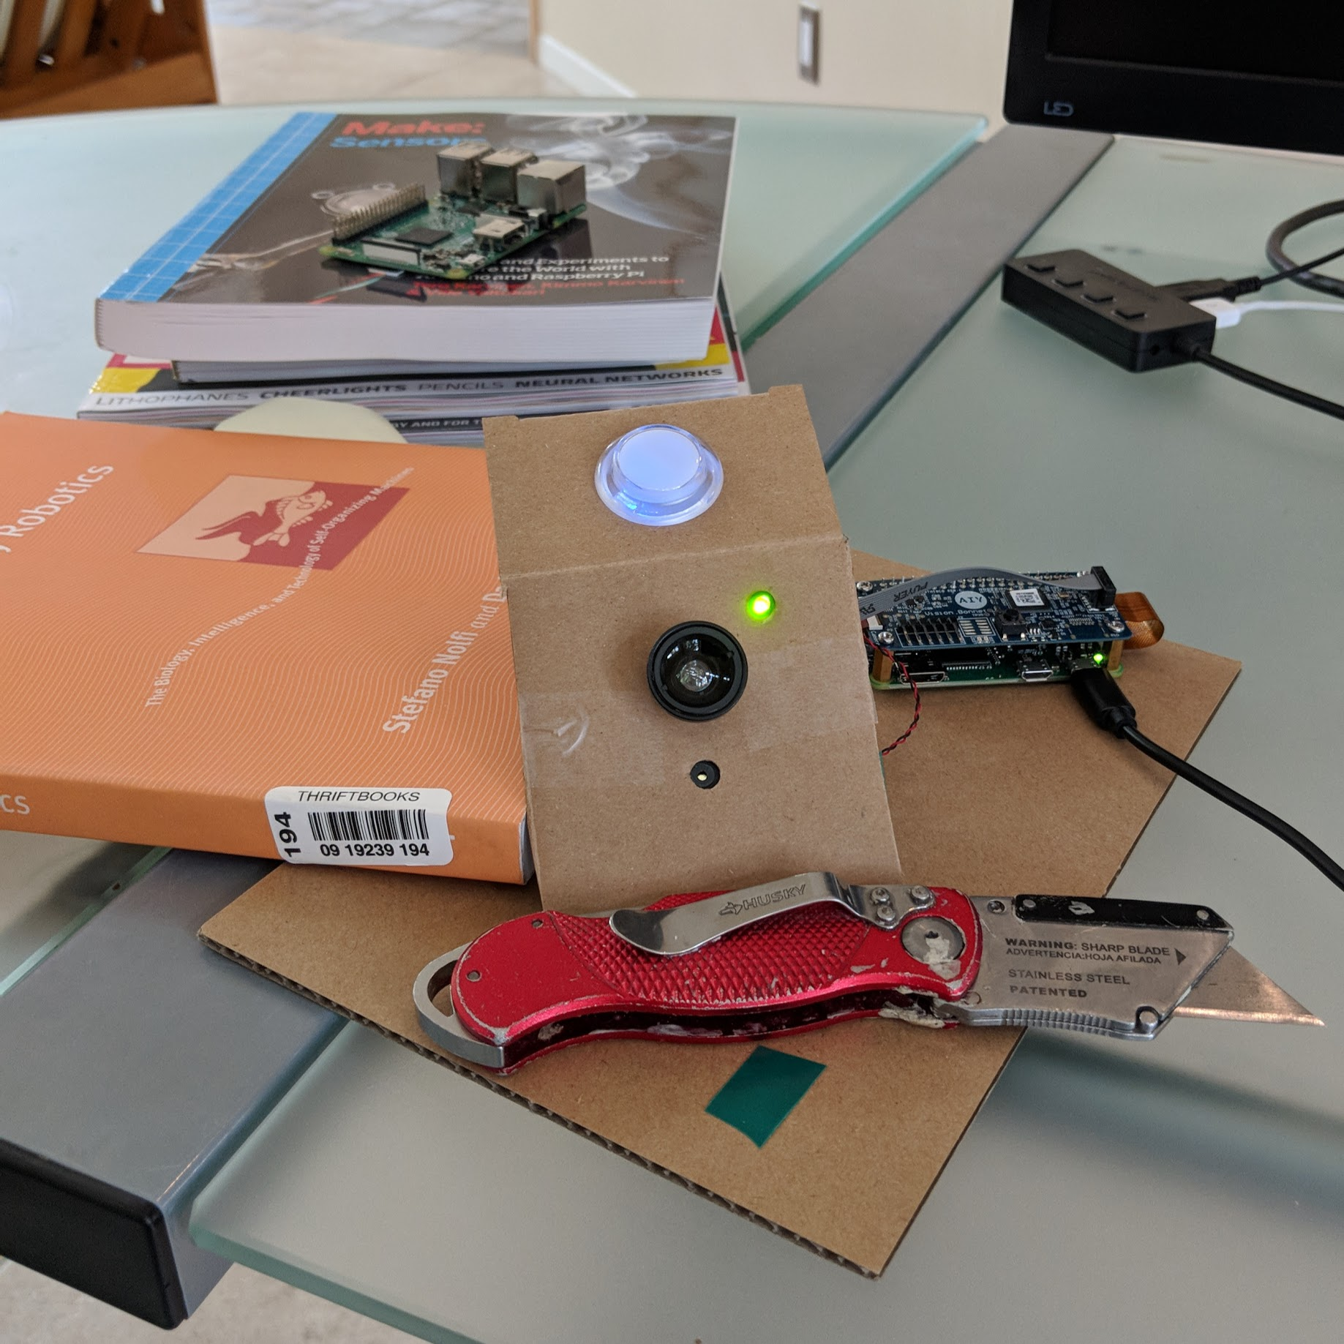
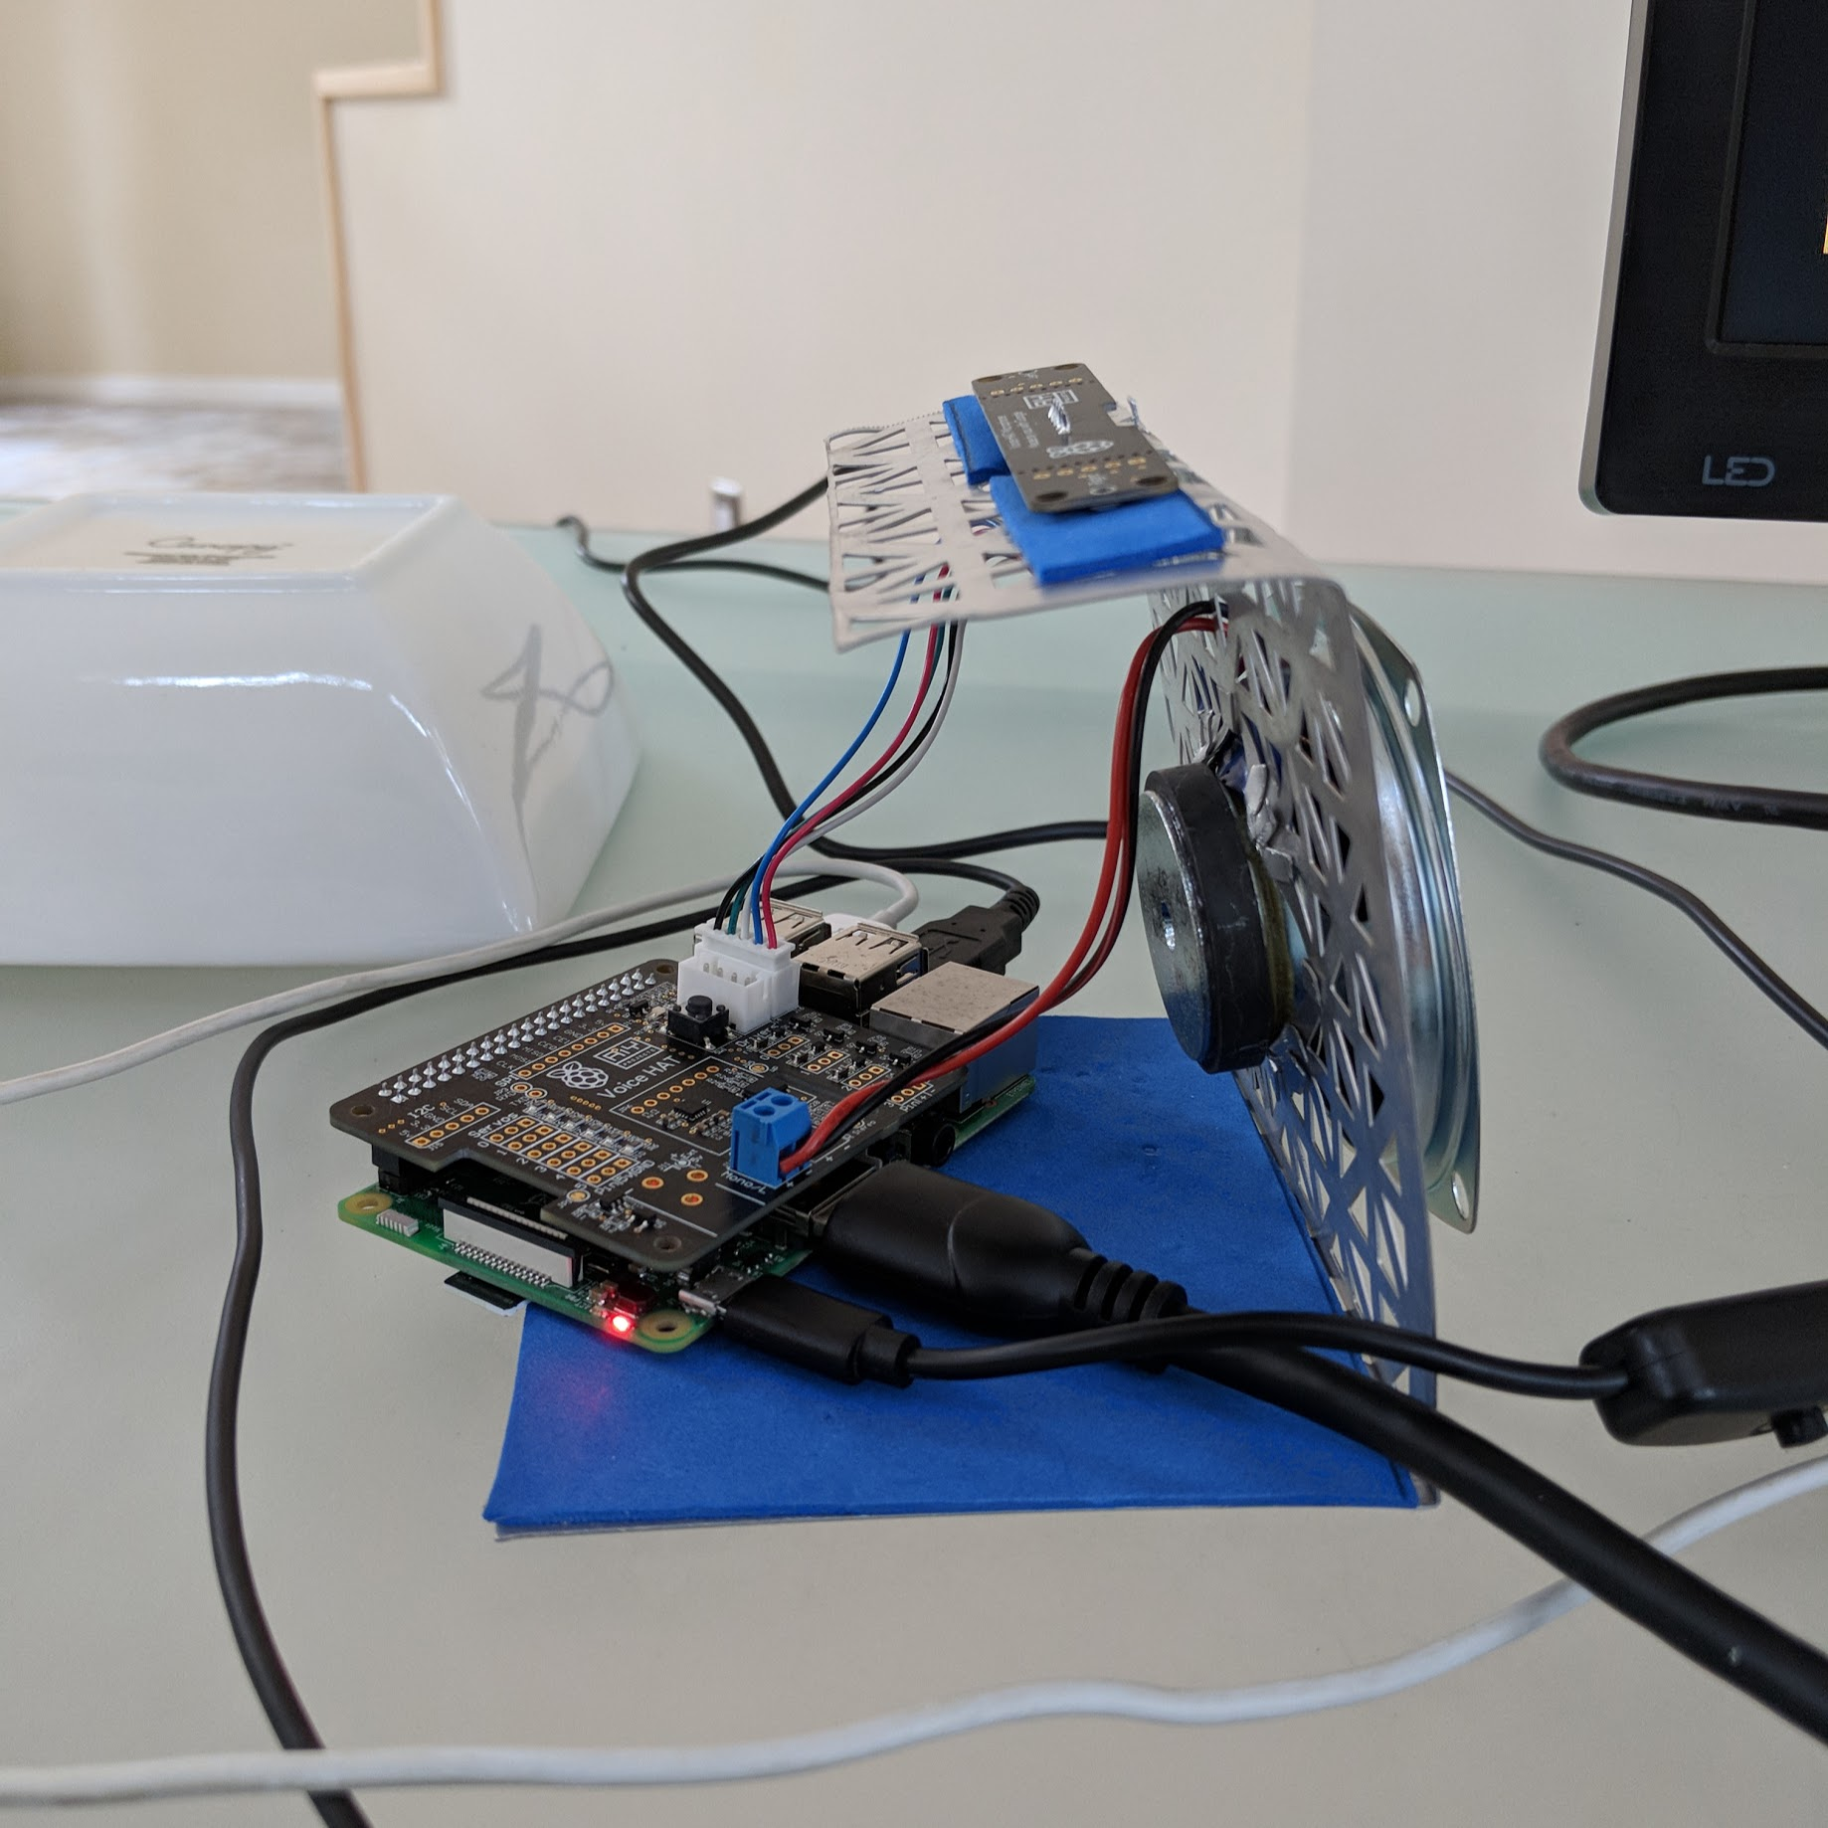
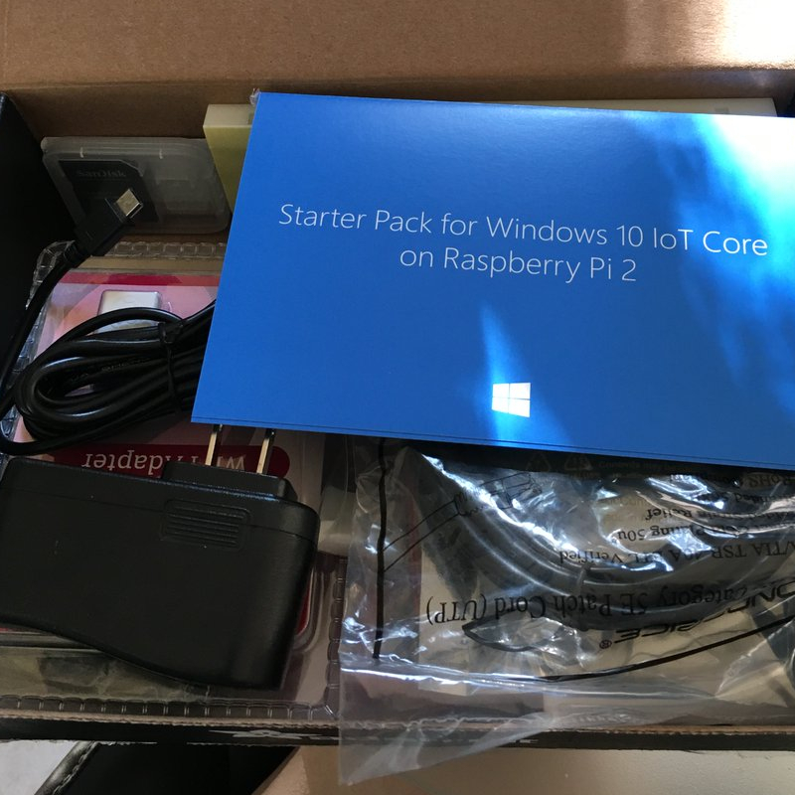
Cloud and IOT
Google: AIY Kits - more technical
Microsoft Azure - built in ML

Slide 7
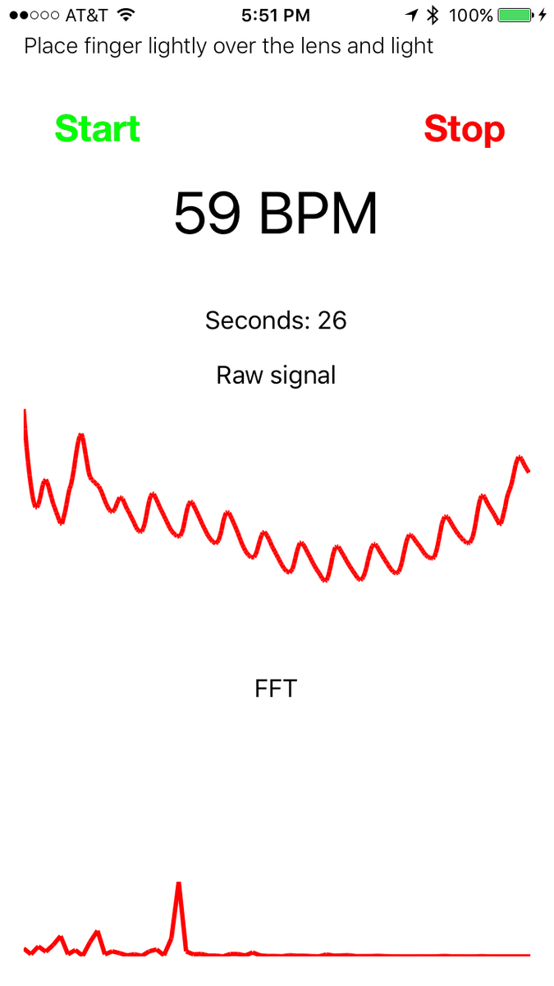
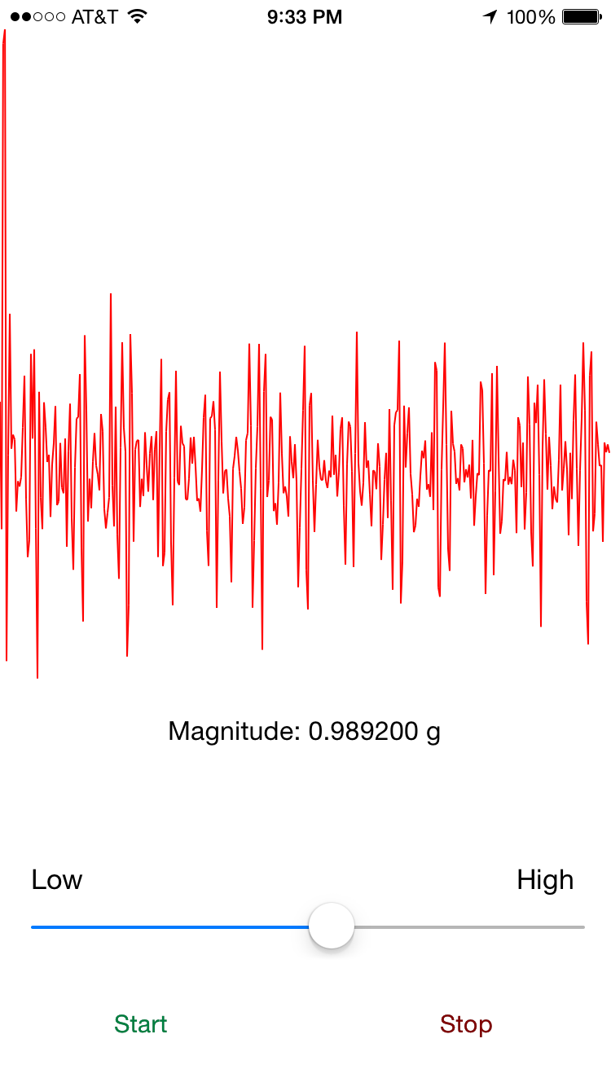
Health Devices
Heart Rate using camera, accelerometer
Can detect HR, HRV, Sleep/Awake

Slide 8
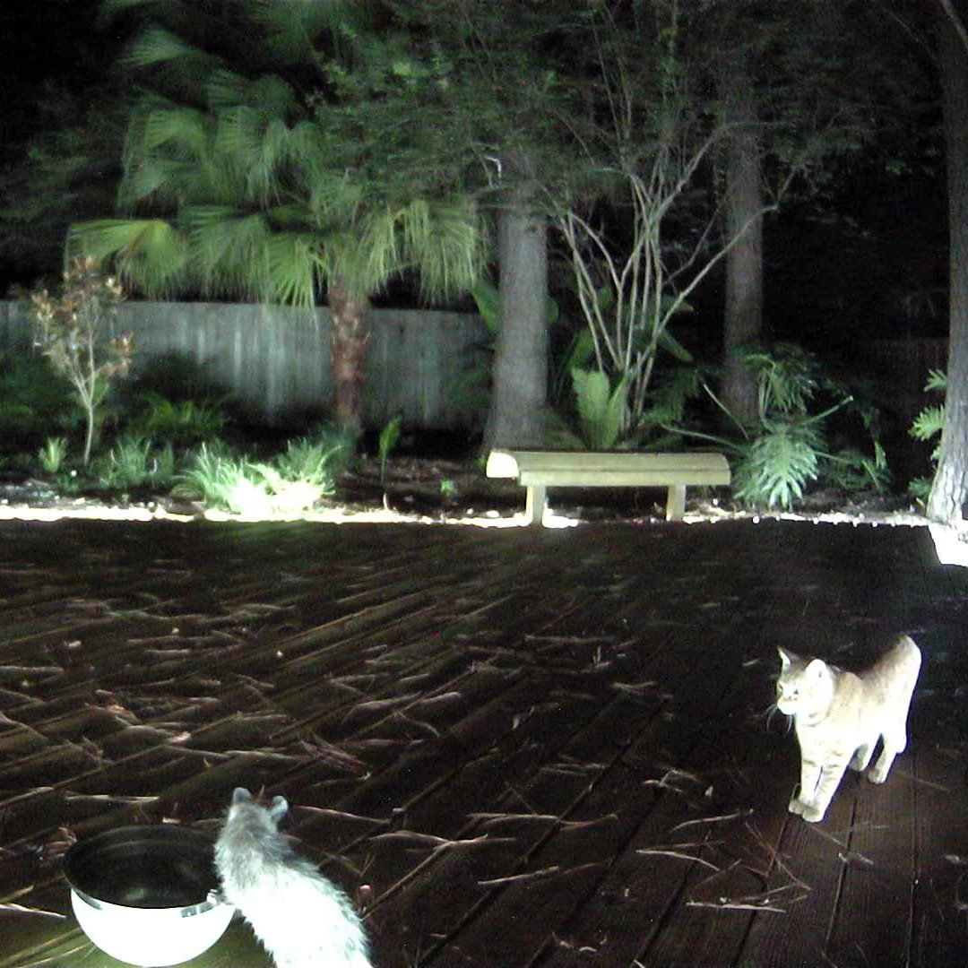
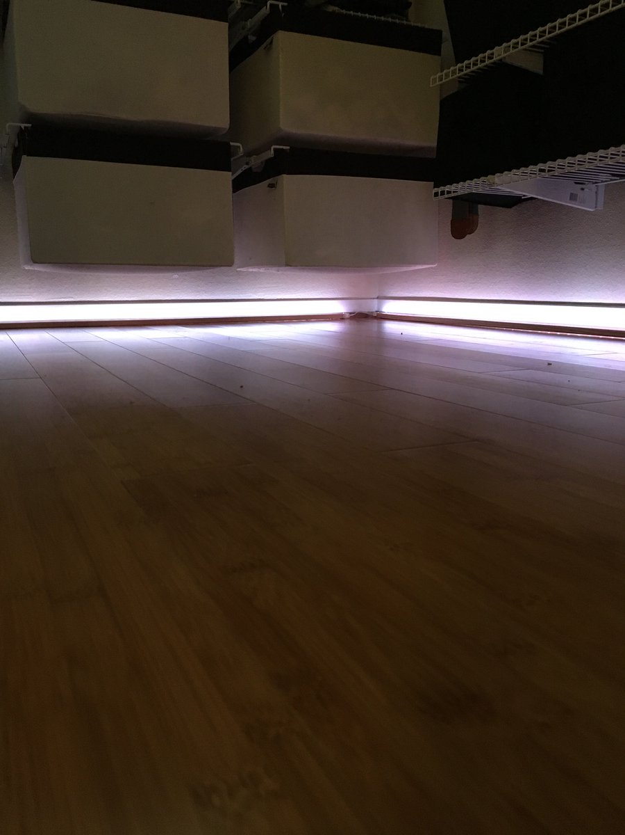
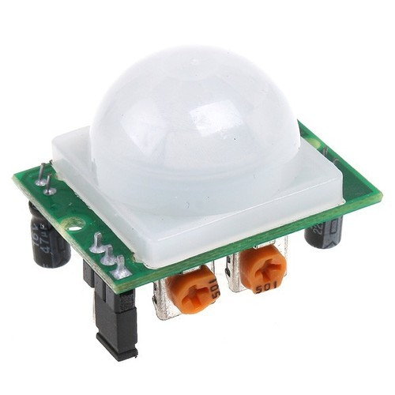
Home Security
Motion detection
Capture images, turn lights on

